Slide 1
Fundamentals of Computers
K.N.Toosi
Fall 2022

Slide 2
Syllabus
Basics
Principals of computers
Binary computation
History of programming
Basics of Python programming
Data types & variables
Strings & lists
Control structures
Functions
Files
Intermediate Python
Introduction to object oriented programming (OOP)
GUI in python
Math with python

Slide 3
Grading & Resources
Final 40%
HW 40%
Project 20%
Understanding Computers: Today and Tomorrow, 16th edition, Deborah Morley, Charles S. Parker
Python Crash Course, A Hands-On, Project-Based Introduction to Programming, 2nd Edition, Eric Matthes
Think Python, How to think like a computer scientist, Allen B. Downey
Email: maryam.abdolali@umons.ac.be
Telegram: https://t.me/KNTUIntroductoryPython
TAs: Arash Zarin nia
Sina Rahimzadeh

Slide 4
Why learning to program?
Improve your logical thinking skills
Coding and programming careers have great earning potential
Attractive salaries
Get to Work From Home
Many job offers
Valuable skills on your resume
You Can Create Anything You Want

Slide 5
Computers in Your Life
Before 1980
Computers were large, expensive
Very few people had access to them
Computers were mostly used for high-volume processing tasks
Microcomputers in the early 80s
Inexpensive personal computers
Computer use increased dramatically
Today
More than 60% of US households include a computer, and most use computers at work
basic computer literacy— knowing about and understanding computers and their uses—is an essential skill today for everyone.

Slide 6
Computers on the Go
Computers are encountered in nearly every aspect of daily life
Portable PCs and handheld computers
ATM machines and retail stores
Self-checkout systems and consumer kiosks
GPS systems

Slide 7
What Is a Computer and What Does It Do?
Computer: A programmable, electronic device that accepts data, performs operations on that data, and stores the data or results as needed
Computers follow instructions, called programs, which determine the tasks the computer will perform
Basic operations
Input: Entering data into the computer
Processing: Performing operations on the data
Output: Presenting the results
Storage: Saving data, programs, or output for future use
Communications: Sending or receiving data

Slide 8
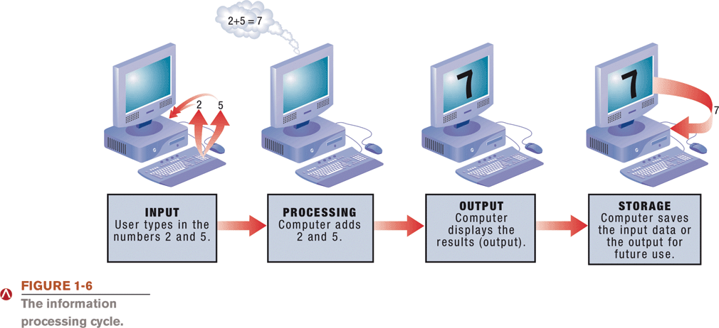
What Is a Computer and What Does It Do?

Slide 9
Computers Then and Now
The computer as we know it is a fairly recent invention
The history of computers is often referred to in terms of generations
Each new generation is characterized by a major technological development
Precomputers and early computers (before 1945)
Abacus, slide rule, mechanical calculator
Punch Card Tabulating Machine and Sorter
9

Slide 10
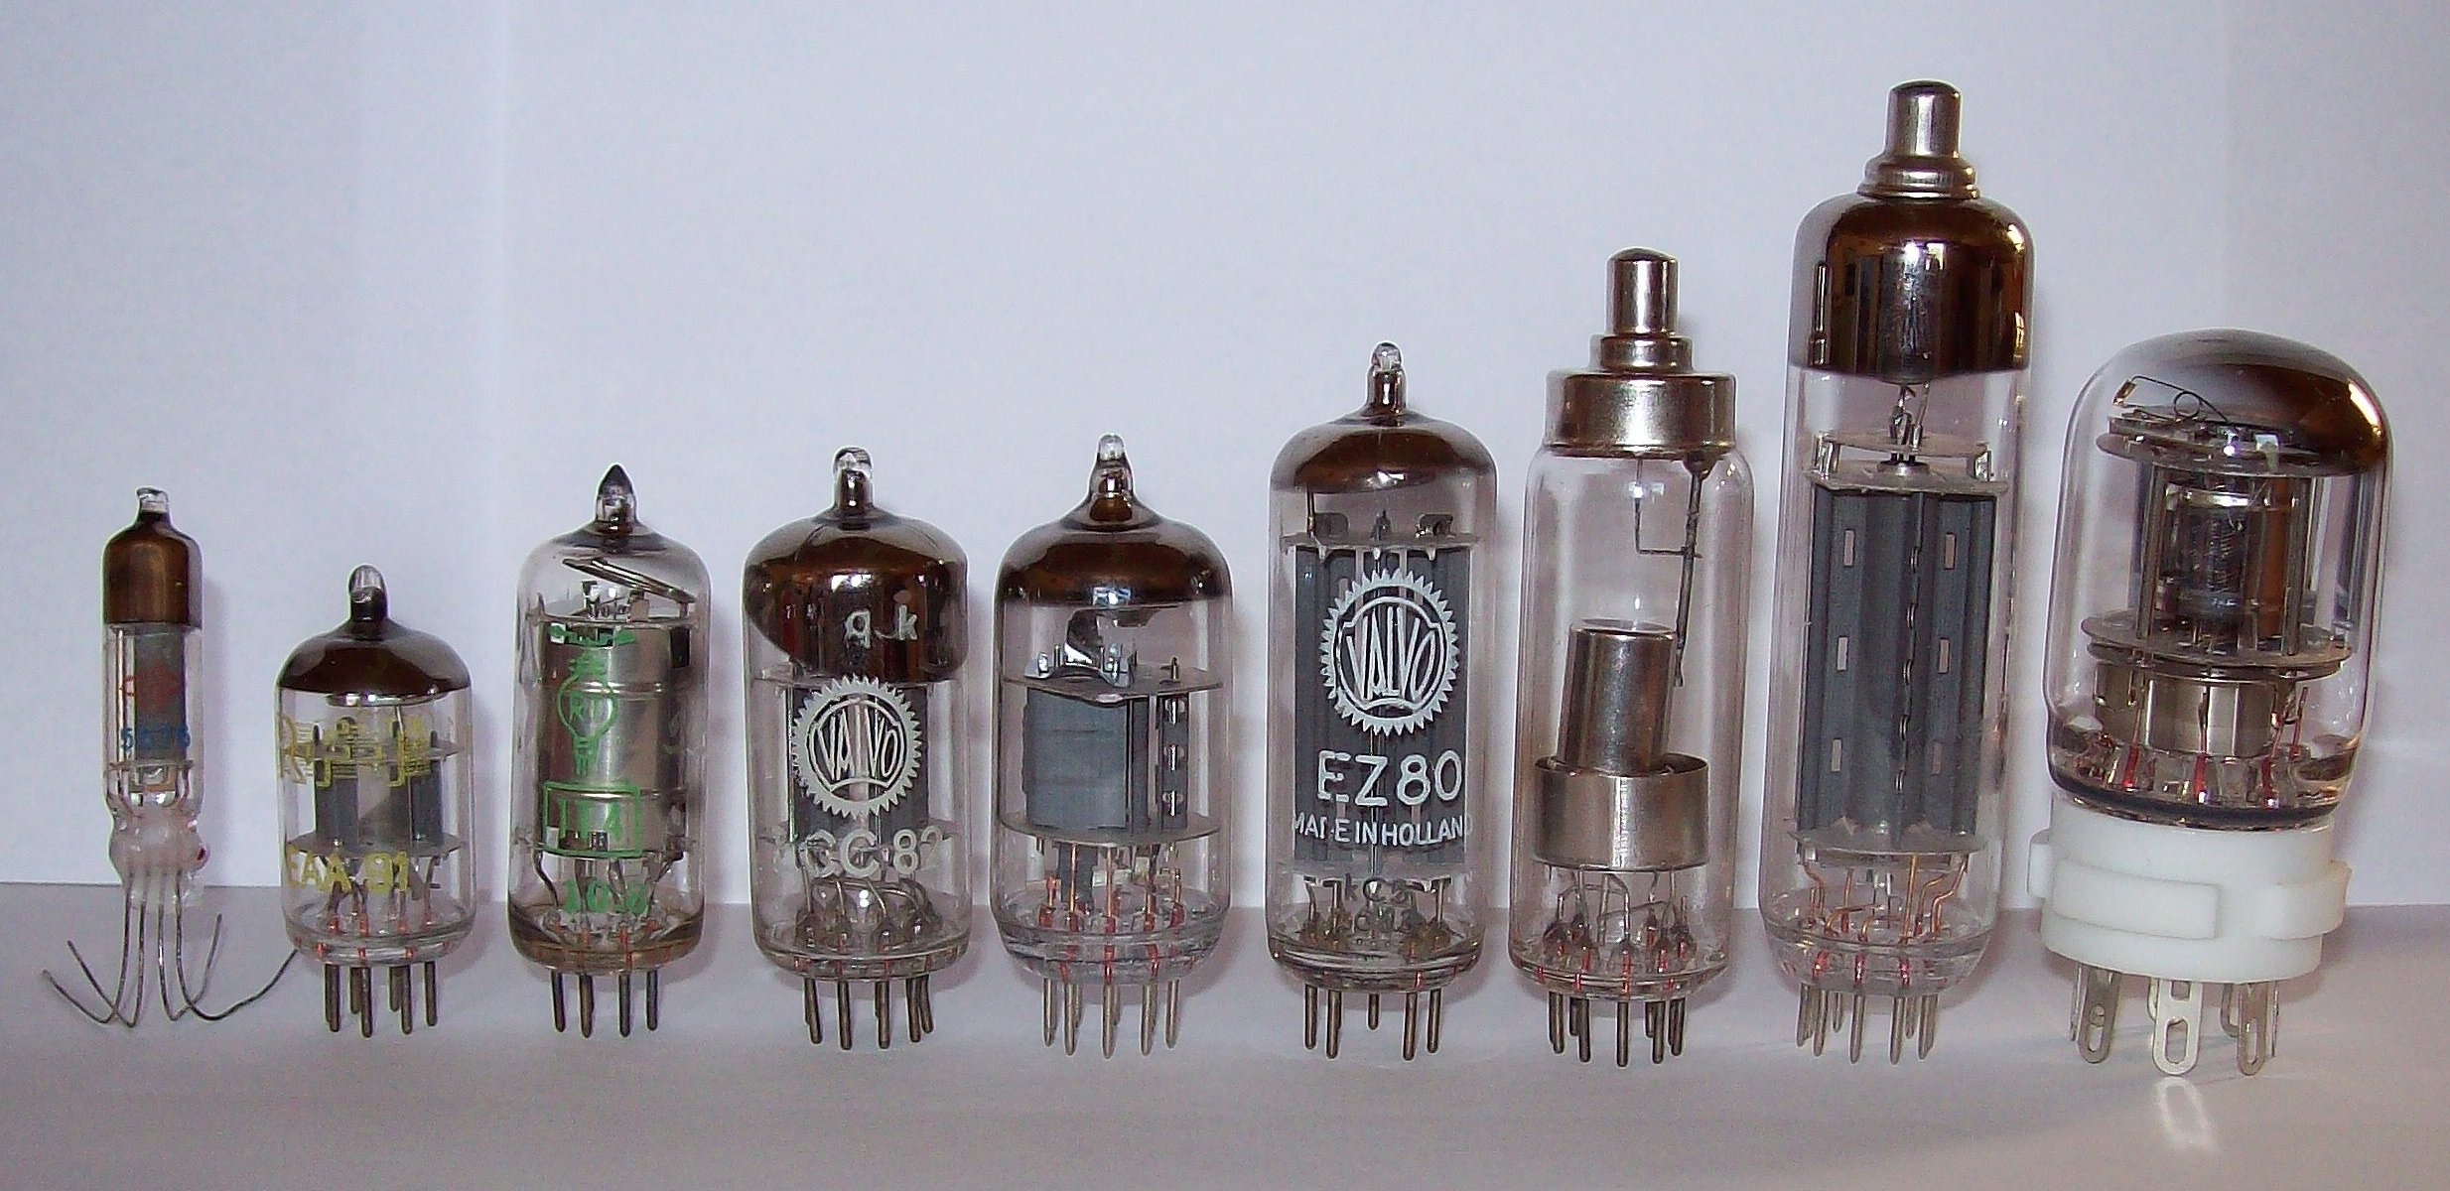
Computers Then and Now
First-generation computers (1946-1957)
Enormous and powered by vacuum tubes
Used a great deal of electricity, and generated a lot of heat
ENIAC and UNIVAC
Second-generation computers (1958-1963)
Used transistors
Computers were smaller, more powerful, cheaper, more efficient, and more reliable
Punch cards and magnetic tape were used to input and store data

Slide 11
Computers Then and Now
Third-generation computers (1964-1970)
Used integrated circuits (ICs)
Keyboards and monitors introduced
Fourth-generation computers (1971-present)
Use microprocessors
IBM PC, Apple Macintosh
Use keyboards, mice, monitors, and printers
Use magnetic disks, flash memory, and optical disks for storage
Computer networks, wireless technologies, Internet introduced

Slide 12
Computers Then and Now
Fifth-generation (now and the future)
Infancy stage
Based on artificial intelligence (AI)
Likely use voice input
May be based on optical computers and utilize nanotechnology

Slide 13
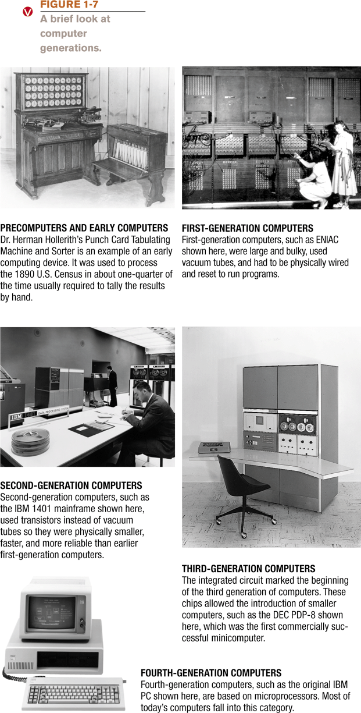
Computers Then and Now

Slide 14
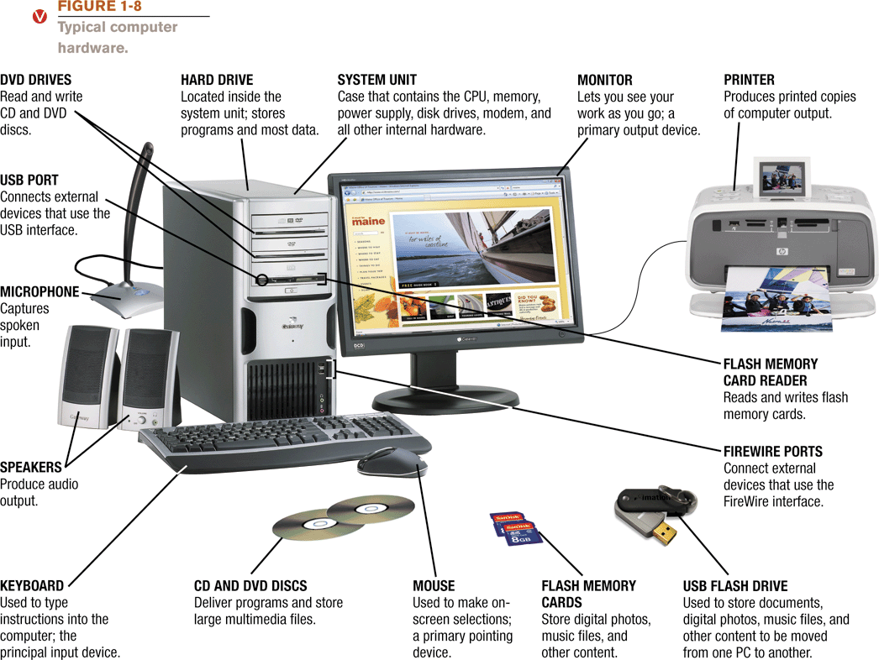
Hardware

Slide 15
Hardware
Input devices
Used to input data into the computer
Keyboards, mice, scanners, cameras, microphones, joysticks, etc.
Processing devices
Perform calculations and control computer’s operation
Central processing unit (CPU) and memory
Output devices
Present results to the user
Monitors, printers, speakers, projectors, etc.

Slide 16
Hardware
Storage devices
Used to store data on or access data from storage media
Hard drives, DVD disks and drives, USB flash drives, etc.
Communications devices
Allow users to communicate with others and to electronically access information
Modems, network adapters, etc.

Slide 17
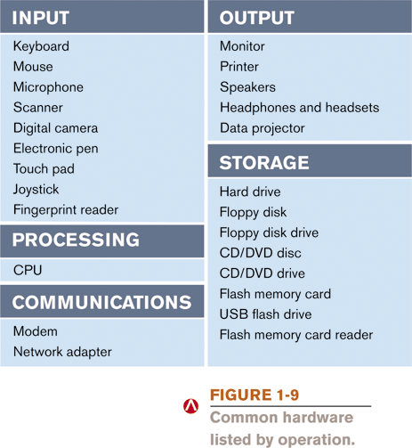
Hardware

Slide 18
Software
Software: The programs or instructions used to tell the computer hardware what to do
System software: Operating system allows a computer to operate
Boots the computer and launches programs at the user’s direction
Most use a GUI to interact with the user via windows, icons, menus, buttons, etc.
Windows, Mac OS, Linux, etc.

Slide 19
Application Software
Application software: Performs specific tasks or applications
Creating letters, budgets, etc.
Managing inventory and customer databases
Editing photographs
Scheduling appointments
Viewing Web pages
Sending and receiving e-mail
Recording / playing CDs
Designing homes
Playing games

Slide 20
Computers to Fit Every Need
Six basic categories of computers
Embedded computers
Mobile devices
Personal computers
Midrange servers
Mainframe computers
Supercomputers

Slide 21
Embedded Computers
Embedded computer: Embedded into a product and designed to perform specific tasks or functions for that product
Cannot be used as general-purpose computers
Often embedded into:
Household appliances
Thermostats
Sewing machines
A/V equipment
Cars

Slide 22
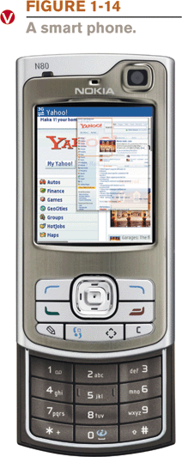
Mobile Devices
Mobile device: A very small device with some type of built-in computing or Internet capability
Typically based on cellular phones
Examples:
Smart phones
Smart watches
Handheld gaming devices
Portable digital media players

Slide 23
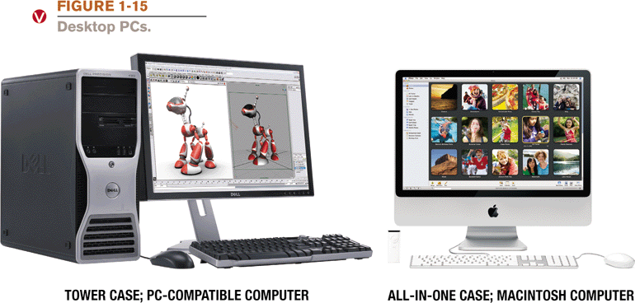
Personal Computers/Desktop PCs
Personal computer: a computer system designed to be used by one person at a time
Also called a microcomputer
Can be desktop or portable computers
Desktop PCs: fit on or next to a desk
Can use tower case, desktop case, or all-in-one
Can be PC-compatible or Macintosh
Not designed to be portable

Slide 24
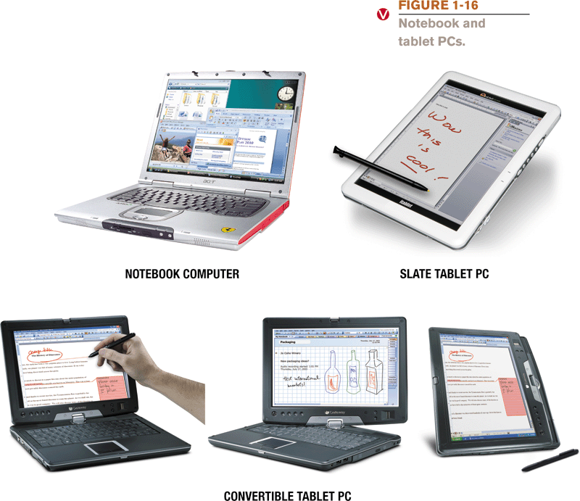
Portable PCs
Notebook (laptop) computers
Typically use clamshell design
Tablet PCs
Can be slate tablets or convertible

Slide 25
Thin Clients and Internet Appliances
Thin client or network computer (NC): PC designed to access a network for processing and data storage
Lower cost and easier maintenance
Limited or no local storage
Not able to function as a computer if network is down
Internet appliance: Specialized network computer designed for Internet access and/or e-mail exchange
Often set-top boxes
Can include Internet-enabled gaming consoles

Slide 26
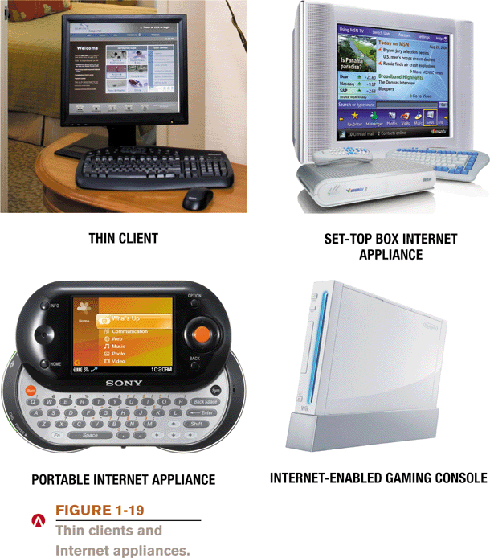
Thin Clients and Internet Appliances

Slide 27
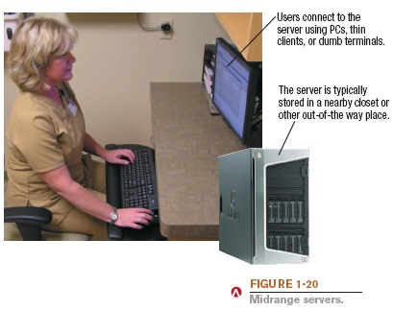
Midrange Servers
Midrange server: A medium-sized computer used to host programs and data for a small network
Users connect via a network with a computer, thin client, or dumb terminal

Slide 28
Mainframe Computers
Mainframe computer: Powerful computer used by several large organizations to manage large amounts of centralized data
Standard choice for large organizations, hospitals, universities, large businesses, banks, government offices
Located in climate-controlled data centers and connected to the rest of the company computers via a network
Larger, more expensive, and more powerful than midrange servers
Usually operate 24 hours a day
Also called high-end servers or enterprise-class servers

Slide 29
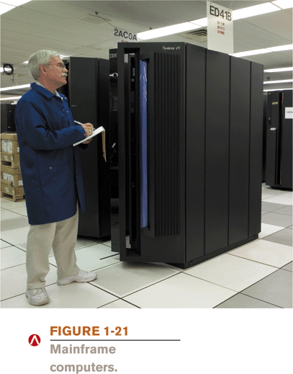
Mainframe Computers

Slide 30
Supercomputers
Supercomputer: Fastest, most expensive, most powerful type of computer
Generally run one program at a time, as fast as possible
Commonly built by connecting hundreds of smaller computers, supercomputing cluster
Used for space exploration, missile guidance, satellites, weather forecast, oil exploration, scientific research, complex Web sites, decision support systems, 3D applications, etc.

Slide 31
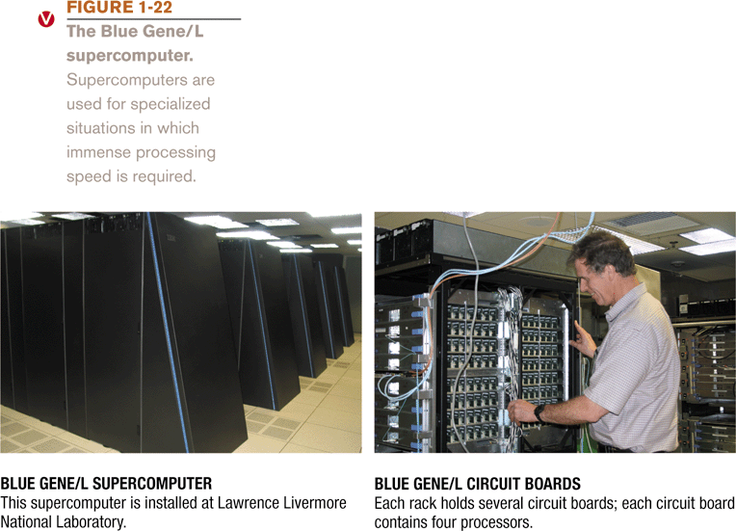
Supercomputers

